Slide 1
Installation of IPT2
Chien-Wen CHEN
Taiwan Forestry Research Institute
2012,Jun,26

Slide 2
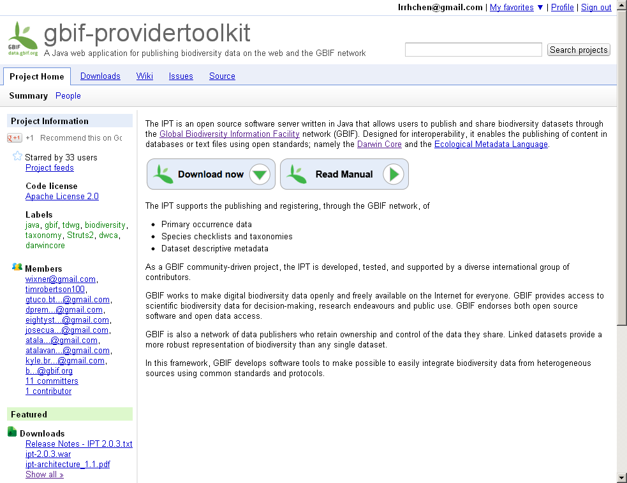
Project website
http://code.google.com/p/gbif-providertoolkit/
  Project Information
  Downloads
  Wiki (user
  manual, tutorials)
  Issue Tracker
  Source Code
  (developer docs)

Slide 3

Server Requirements
Internet Connectivity
Stable URL
Memory (256M)
Disk Space (~20MB plus data)
Java (version 7 or later)
Servlet Container (e.g., Tomcat)

Slide 4
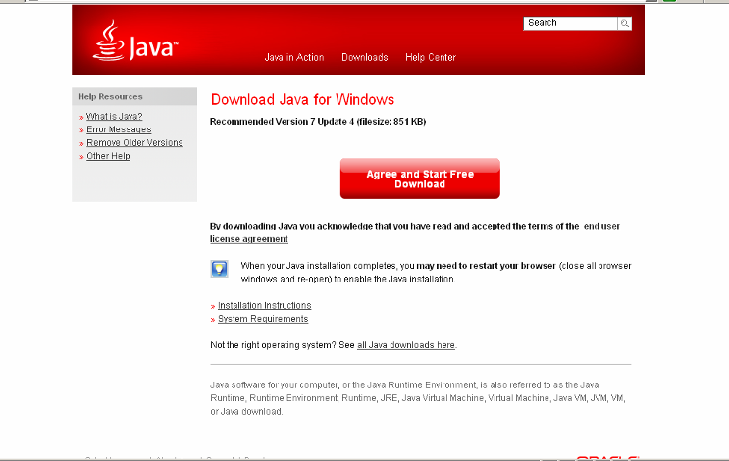
Server Requirements
Java version 7 or later (suggested)
http://www.java.com/

Slide 5
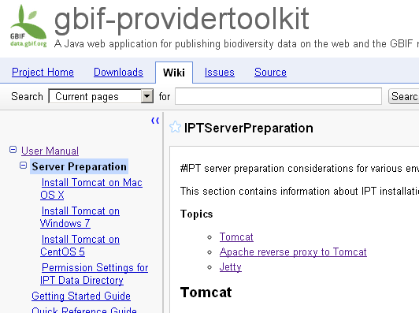
Server Requirements
Servlet Container
  Tomcat (5.5, 6, 7)
    Mac OS X
    Windows 7
    CentOS 5
  other chioces
    Jetty
    Apache reverse
    proxy to Tomcat
http://code.google.com/p/gbif-providertoolkit/wiki/IPTServerPreparation

Slide 6
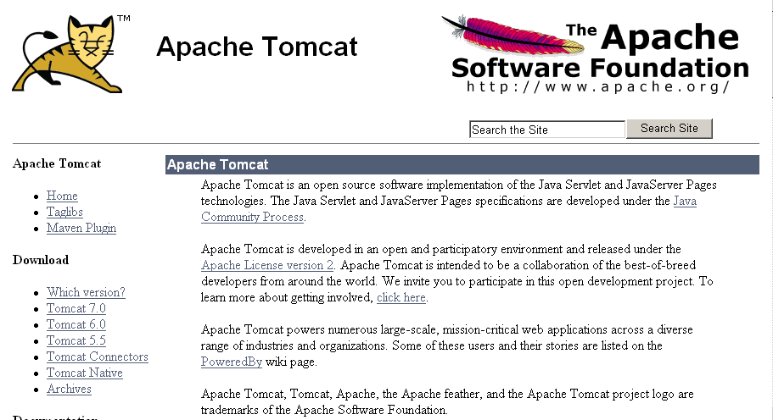
Server Requirements
Tomcat
http://tomcat.apache.org/

Slide 7
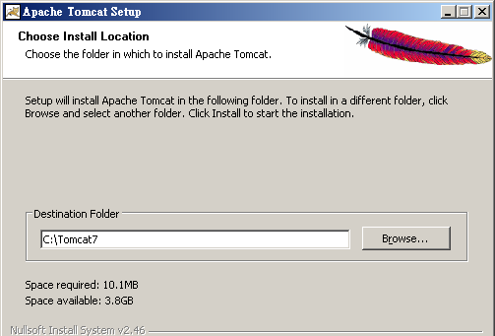
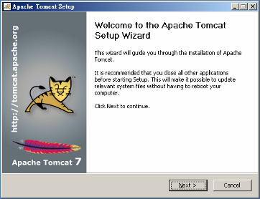
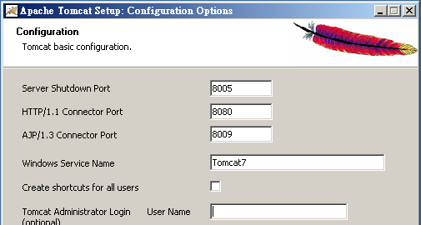
Server Requirements
Tomcat
Install location: C:\Tomcat7
default: 8080

Slide 8
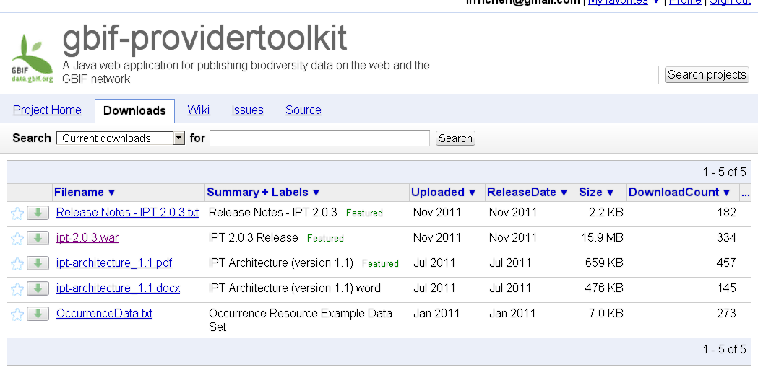
IPT Installation
Download latest 'ipt-x.x.x.war'
http://code.google.com/p/gbif-providertoolkit/downloads/list

Slide 9


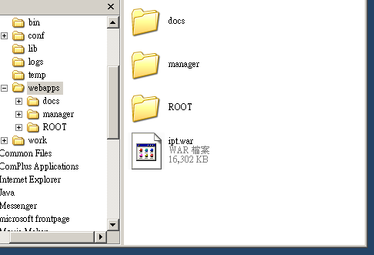
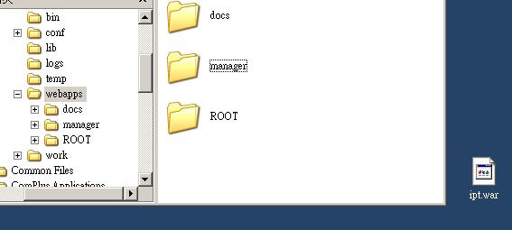
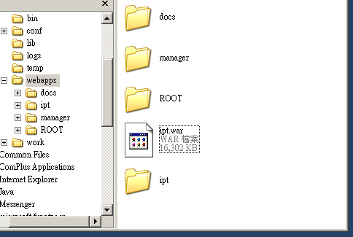
IPT Installation
Rename .war file (e.g., ipt.war)
Deploy .war file
  Copy ipt.war to [Tomcat7
  installation location]\webapps
  (e.g. C:\Tomcat7\webapps)

Slide 10
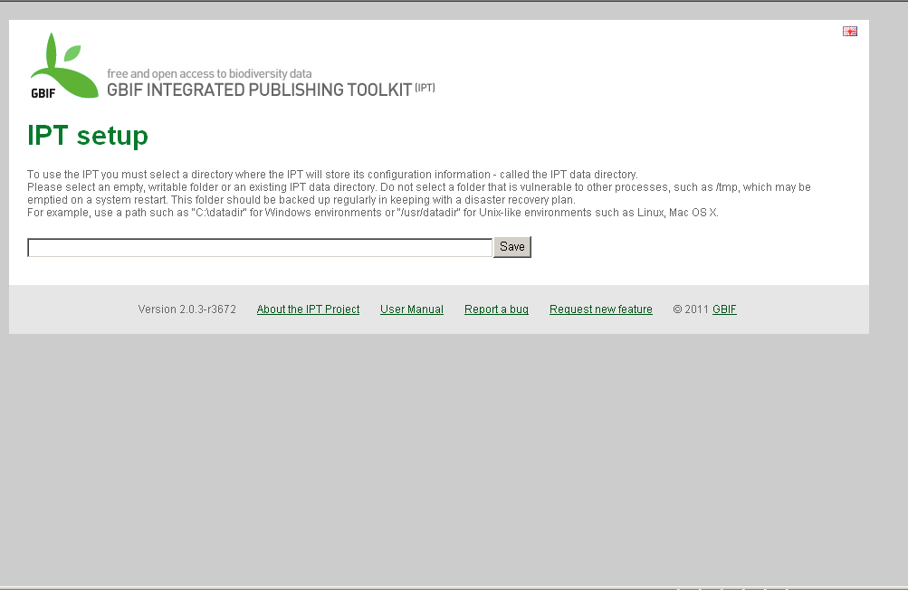
IPT Installation
Run IPT in browser (e.g., http://localhost:8080/ipt)
Data directory

Slide 11
IPT Setup - part I
Choose IPT2 Data directory
  Absolute Path (i.e. complete directory path)
    Windows - "C:\datadir"
    Linux, Mac OS X - "/usr/datadir"
  Empty
  Write Permissions
  Protect
    not vulnerable to other processes
  Back up

Slide 12
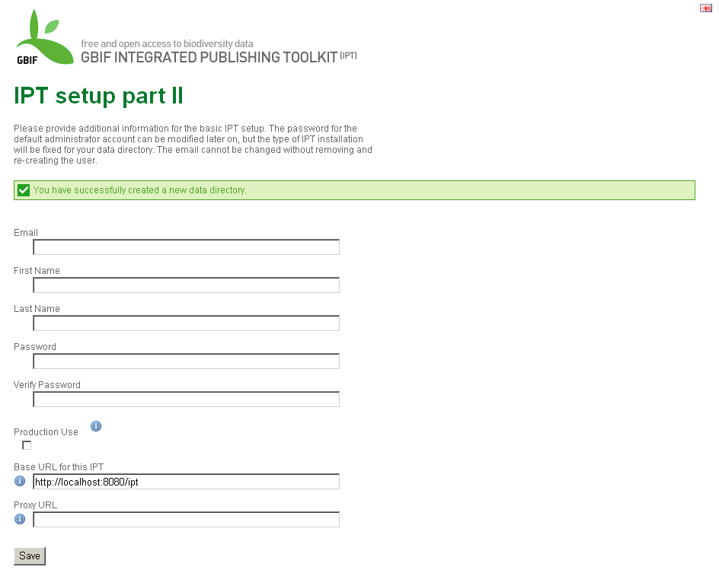
IPT Setup - part II
First administrator
Please do not select when testing or evaluating the IPT

Slide 13
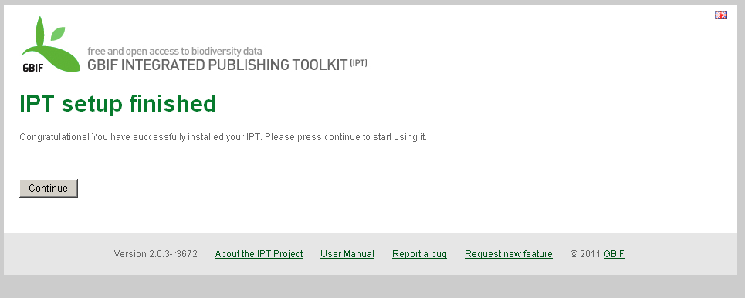
IPT Setup - finish

Slide 14
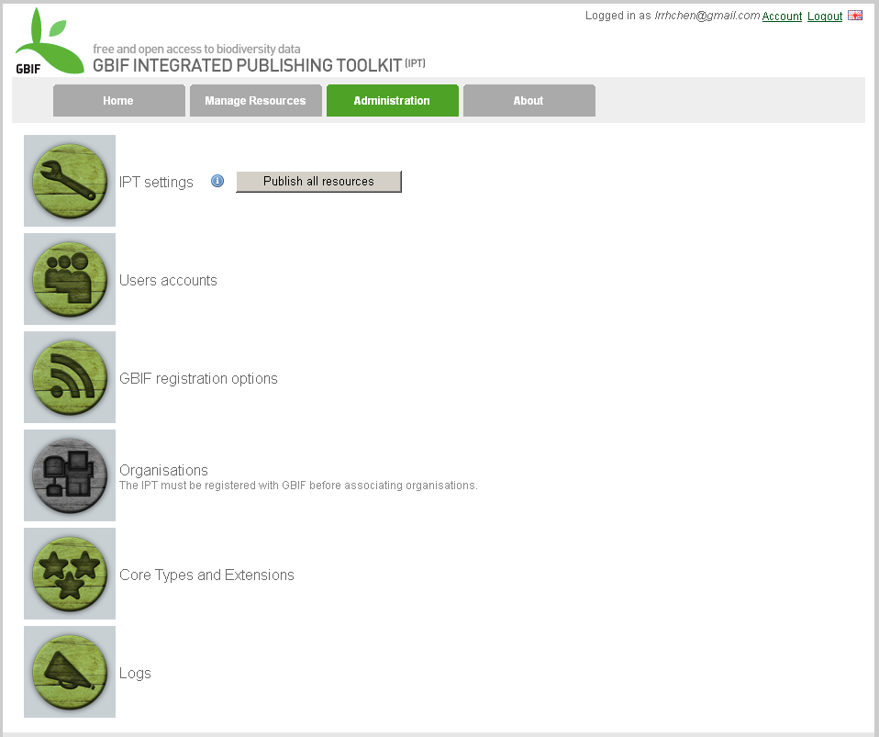
Administration Menu
Server Settings

Slide 15
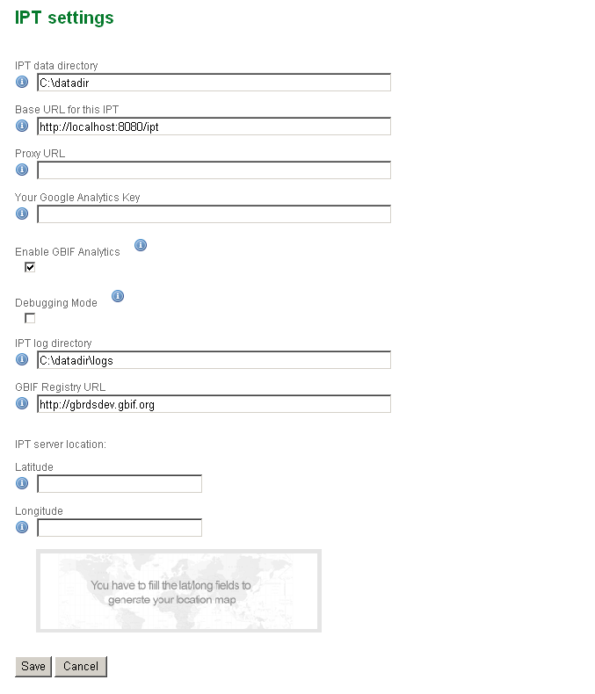
IPT Settings
For Google Analytics Services to tracking of this IPT’s usage
Allow GBIF to include your IPT in the global IPT usage monotoring
To enable increased information logging for debug purpose
The URL of the GBIF Registry;
Immutable and can only be chosen in the setup steps

Slide 16
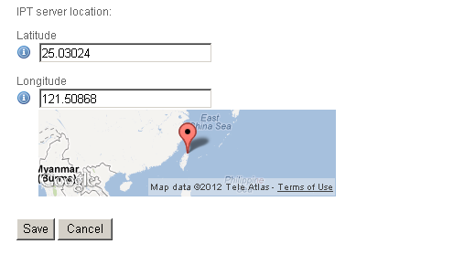
IPT Settings
Geographical coordinates which this server is located at; using decimal degree format with WGS84 datum

Slide 17
IPT Settings
Users Accounts

Slide 18
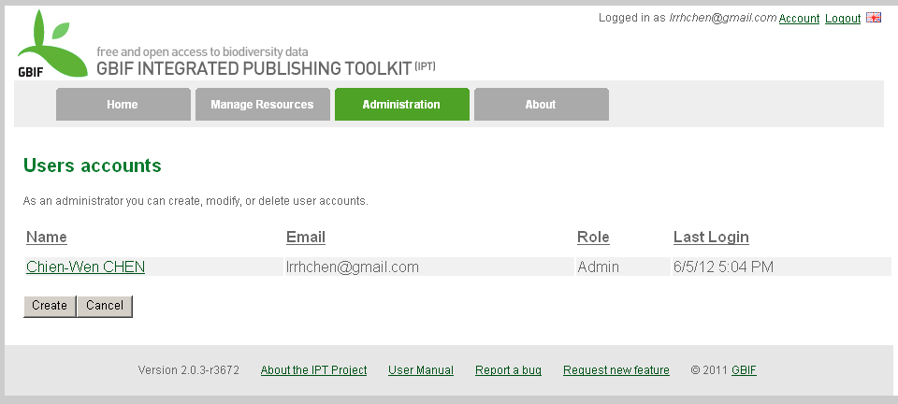
Users Accounts
Create New User Account

Slide 19
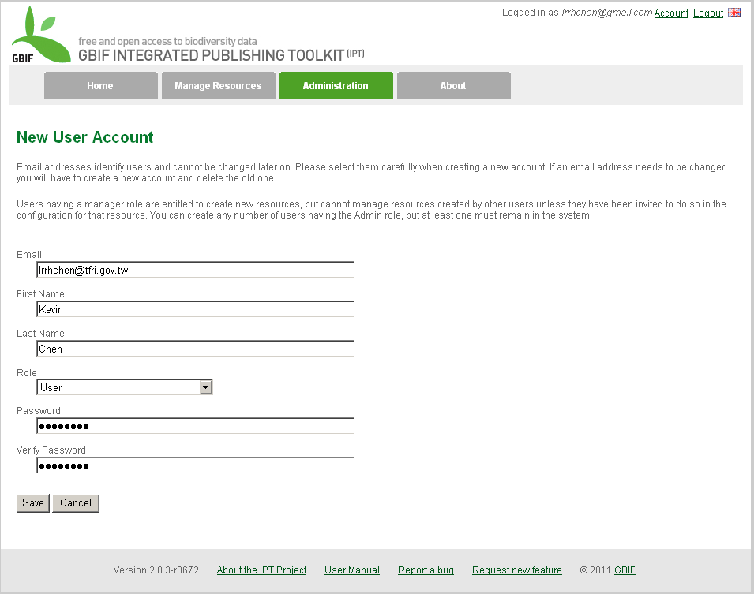
The roles of this account will be assigned. includes:
‘User’,
‘Manager without registration rights’,
‘Manager with registration rights’,
and ‘Admin’

Slide 20
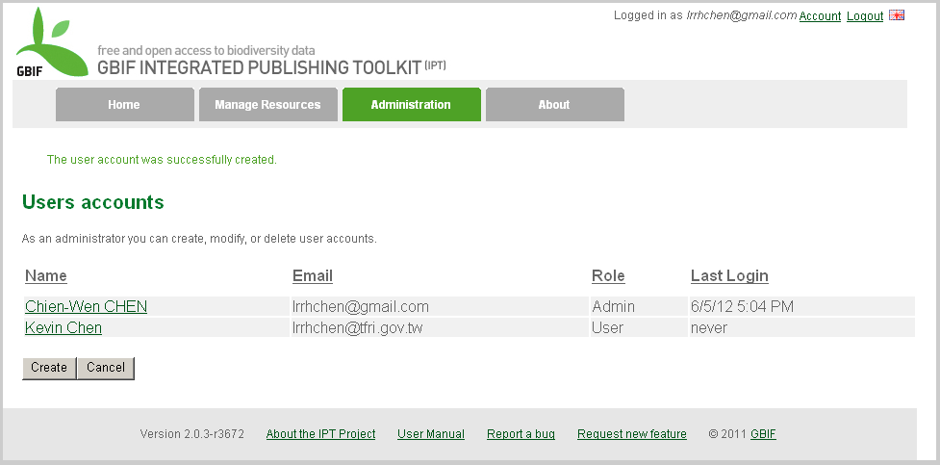
Users Accounts
Modify the Information of User Account

Slide 21
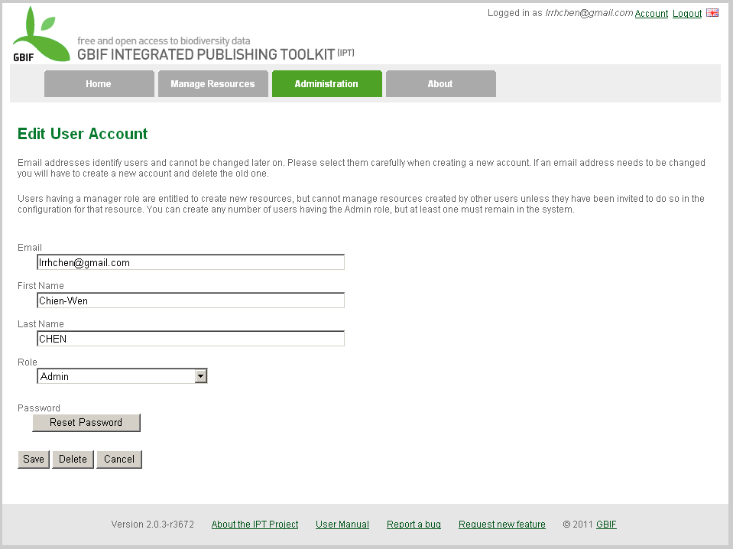
Reset the password

